Slide 1
System Programming and
Compiler Construction
(Course Code - CE61)
Lecture #10
Dr. Anant V Nimkar PhD(CSE-IIT Kharagpur)
Associate Professor
Department of Computer Engineering
Sardar Patel Institute of Technology Mumbai

Slide 2
Top-Down Parsing
Types of Parsing Methods
  Top-Down Parsing
  Bottom-Up Parsing
  Top-Down Parsing
  Recursive-Descent Parsing
  LL(1) & Non-recursive Predictive Parsing

Slide 3
Types of Parsing Methods
Parsing
Top down parsing
Bottom up parsing (Shift reduce)
Back tracking
Operator precedence
Parsing without backtracking (predictive parsing)
LR parsing
SLR
LL(1)
CLR
Recursive
descent
LALR

Slide 4
Top-Down Parsing
Finds leftmost derivation (i.e. parse tree in preorder) for an input string, starting from Start Symbol using sequence of productions to eventually creating an input string.
Class of grammars for which construction of predictive parsers looking k symbols ahead in the input called the LL(k) class.
For example the CFG as follows:
  E→TE’ T’ →*FT’ | ε
  E’ →+TE’ | ε F →(E) | id
  T→FT’

Slide 5
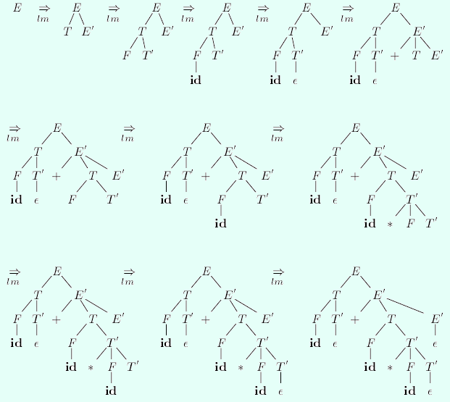
Top-down parsing of id+id*id

Slide 6
TOP-DOWN PARSING
Recursive-Descent Parsing
  Backtracking
Non-Recursive Predictive Parsing
  FIRST and FOLLOW
  Construction of Predictive Parsing Table
  Table-Driven Predictive Parsing Algorithm

Slide 7
Recursive-Descent Parsing
In backtracking, expansion of non-terminal symbol we choose one alternative and if any mismatch occurs then we try another alternative.
Grammar: S→ cAd Input string: cad
A→ ab | a
S
S
S
c
A
d
c
A
d
c
A
d
Make prediction
Make prediction
a
b
a
Parsing done

Slide 8
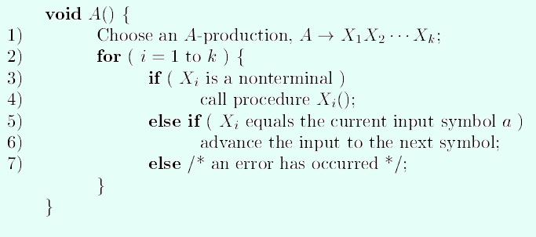
Recursive Descent Parsing
Example

Slide 9


